Slide 1
Agile Domain
Explaining Domain Driven Design from a Strategic Level

Slide 2
Quality in Software
Quality is always (should be anyways) be the goal for developers on every project they work on
Producing bug free software is good but a higher level is achievable by producing a software model that reflect the intended business objective

Slide 3
When “Done” Isn’t “Done”
The problem of being “Done” without being “Done”:
“Done” software still may require many revisions before features are adopted
“Done” software may never get adopted because obvious features are missing
“Done” software may surprise the consumer and rollouts get delayed as business processes are updated

Slide 4
Personal Experiences on Why “Done” Isn’t “Done”
Two issues prevented the software team from “maximizing” business value of the software they were writing
Lack of marketing input resulted in the release of features that didn’t move the needle
Lack of client involvement (internal and external) resulted in the release of features that didn’t do what the client needed
Resulted in software that either wasn’t adopted or required a lot of rework
In the end it comes down to developers, while being agile on their team, did not involve the necessary domain experts

Slide 5
Isn’t Rework a Part of Agile?
Yes it is but delays still result in lost business value
Agile teams can be good at working within the process in delivering good code but
Agile is also about collaboration
How can we tweak our development process to accurately reflect what the market wants?

Slide 6
Goals of this Presentation
Try to solve this problem of improving the way code is written by
Giving an overview of the definition of Domain Driven Design (also known as DDD)
Giving a detailed introduction into Ubiquitous Language and Strategic Design
Sprinkling in some real life experiences I have during our first foray into implementing DDD
I will not, however, go over Tactical Design as it is very technical and involves a lot of time

Slide 7
What is Domain Driven Design?
A software approach that focuses on bringing the objectives of the business closer to the software it creates by
Bringing Domain Experts and software developers together in order create a common Ubiquitous Language
Strategically reviewing the business objectives and prioritizing what subdomains in the business are the highest priority
Applying tactical patterns to the business to keep the Domain Model isolated and the code easily extensible

Slide 8
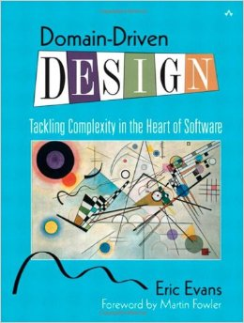
2003
Eric Evans wrote the original Domain Driven Design book
Gives a good introduction into Domain Driven Design
Does not focus initially on the Strategic aspects until the end
Examples are dated, for example: exciting new technology of XML is referenced

Slide 9
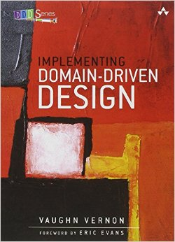
2013
Vaughn Vernon wrote a book focusing on implementing DDD
Tremendous number of modern examples that ease the implementation process
Focus at first on language and strategic aspects
Incredibly dense book, may require multiple readings

Slide 10
Implementing Domain Driven Design
Should every project implement DDD?
Short answer is no
You should consider DDD if
The subdomain you are working within is moderately complex
Or is going to be moderately complex sometime in the future
Or if the subdomain itself is relatively fluid requiring lots of changes in strategy

Slide 11
When Not to Apply DDD?
If the software being developed is a simple CRUD application
If the software is in a subdomain that does not get used very often
If the software only has minor complexity and will not be changing much in the future

Slide 12
Smart UI Anti-Pattern
When not applying DDD a conscious decision is made that the business logic should live the UI layer
This is not necessarily a bad thing, DDD requires an upfront cost that can be cost prohibitive in the previous examples
Putting all of the logic into the UI layer however means that the code will be harder to place into a Domain Model

Slide 13
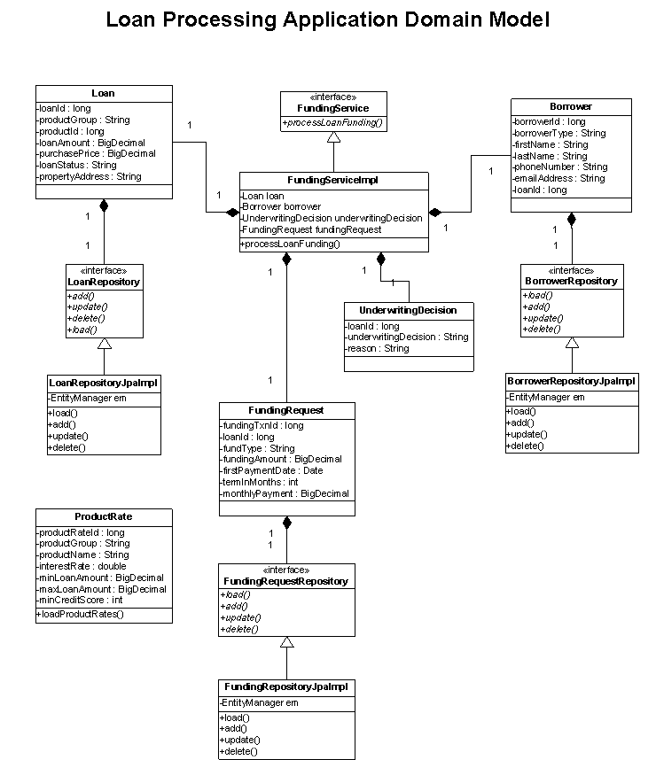
What is the Domain Model?
Simply the object model describing the Domain the software operates in
An Anemic Domain Model is a domain model that lacks in the behavioral qualities that describe the domain the software operates in (this is bad)

Slide 14
Code in an Anemic Domain Model
An Anemic Model doesn’t describe the domain the software operates in
Generally characterized by objects that have generic gets and sets
Business logic lives in other layers
This leads to code that is hard to navigate and duplicated everywhere
Anemic code:
patient.setShotType(ShotTypes.TYPE_FLU);
patient.setDose(dose);
patient.setNurse(nurse);
Expressive Code:
Vaccine vaccine = vaccines.standardAdultFluDose();
nurse.administerAdultFluVaccine(patient, vaccine);
The code on the bottom tells a richer story.

Slide 15
Domain Experts
What is a Domain Expert?
Someone with great knowledge in a particular area of a Domain
Best way, according to the book, to guarantee precision of a software solution is to imbed them on the team
In real life this is not feasible sometimes, so be ruthless in getting feedback even improvising (sometimes bribing) if needed

Slide 16
Ubiquitous Language
First pillar of Domain Driven Design
Shared language of the team, both from Domain Experts and Software Developers for the subdomain they are working in
Centered around how the business thinks and operates
Language should be used by the organization when communicating
Contains all parts of a normal language: nouns, verbs, adjectives…
This language is then reflected in the domain model

Slide 17
Why is this important?
With Ubiquitous Language
Without Ubiquitous Language
Code will reflect the objectives of the business
Easier to convey ideas as there is a shared language
Easier for a developer to understand what is happening without lots of documentation
Software features become conversations about the business itself
No surprises by the organization during a release
Code is harder to read
Harder to convey what something does to a non-developer in technical terms
Software features become an interpretation

Slide 18
How to implement Ubiquitous Language?
Start by creating a glossary or diagram that should the concepts and the language
Usually it will be written by single person or a couple of individuals
Afterward reviewed by the team
The language is malleable, it will change as new insights become clear
Ubiquitous does not mean universal, do not try to create a long glossary for all processes in the organization. YOU WILL FAIL!
Example: A Location for a hospital has a different meaning then a Location for a calendar event

Slide 19
Thoughts on Domain Experts and Ubiquitous Language
For our first project we did a pretty good job in communicating with client for our first project using DDD
CAG – Client advisory group that we met with about every two weeks
GAG – Geonetric advisory group that we met with frequently but less than probably desired
Ubiquitous language for our first go around started as a glossary
Ended up being a great way to communicate to the developers
Really helped with shaping how the code was structured
Did not keep up with the glossary as much as we should have to incorporate new insights into the domain

Slide 20
Analyzing the Business
Every business has some Domain that they operate in.
In DDD terms the Domain represents the business as a whole
Within each business there are multiple Subdomains that represent a part of the whole Domain
These as a whole represent the problem space that the business is trying to solve

Slide 21
Solving the Problem – The Bounded Context
Bounded Context is the other pillar of Domain Driven Design (with Ubiquitous Language)
The Bounded Context represents the solution space that the business operates and
Is the answer to the problem stated in the subdomains in software form
Enterprise software in reality has multiple domain models at work within each Bounded Context
Each Bounded Context represents one set of Ubiquitous Language
The true definition of Ubiquitous Language is the language within a context

Slide 22
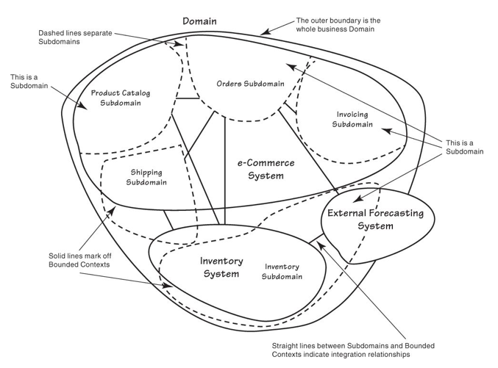
Example Bounded Contexts Mapped with Subdomains

Slide 23
Types of Subdomains
Core Domain – Represents a part of the business that is of primary importance to the organization at that time
Supporting Subdomain – Represents a part of the business that has value to the organization but not as important as the Core Domain
Generic Subdomain – A subdomain that has new value to the business of the organization but is still necessary

Slide 24
Approaching a Business Need from a DDD Perspective
When given a large problem within the organization this will typically be the Core Domain
Ask:
What is the name and vision for this strategic Core Domain?
What concepts should be considered part of the Core Domain?
What are the Supporting and Generic Subdomains?
Who are the actors in each area of this domain?
Can the right teams be assembled?

Slide 25
Solving the Business Need
Start by defining the Domain Experts in the given Core Domain
Be careful defining the experts as there can be too many cooks in the kitchen
Develop the glossary or diagram defining the Ubiquitous language across the various contexts that will be needed
What software assets are already available, especially for Supporting and Generic Subdomains
If those assets are not available try to farm these needs to existing providers.
The goal is to get the solution to market ASAP!

Slide 26
Important Notes About Bounded Contexts
Ideally there is only one Bounded Context per Subdomain
This however is not always feasible in practice for all types of subdomains.
The Core Domain needs to follow this principle
A Bounded Context consists of the Domain Model, any supporting services and infrastructure, even the database model and UI

Slide 27
More Important Notes
Do not pollute the Domain Model with concerns from a different subdomain, for example: an online market place should not contain any reference to security
Instead these concepts should be translated to match the language of the Domain (more on this later)
Be careful when splitting bounded contexts not to split them too thin.
In DDD this is the Module vs Bounded Context

Slide 28
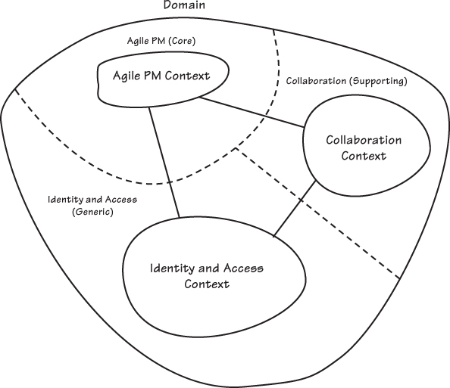
Real Lifeish Example

Slide 29
Real Life Lesson
In our first foray into Domain Driven Design we needed to implement security to control access to our system
To solve this problem we found an off the shelf Authentication and Identification context to serve the need

Slide 30
Practice Exercises
On a white board list the following:
In one column list each subdomain that exists with the Domain of the organization constituting the problem space
In another column list each Bounded Context that solves that problem
Now draw a diagram that shows your Domain, Subdomains, and Bounded Contexts in the following form
Keep in mind in a agile world this will change…a lot.

Slide 31
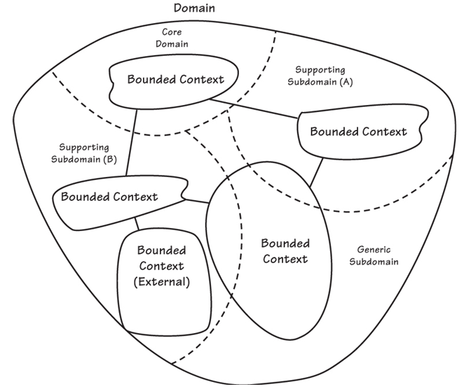
Sample Diagram

Slide 32
More Exercises
This time take the current or a recent big project you worked on
List the Core Domain
List Supporting and Generic Subdomains
Ask Domain Experts if there are questions

Slide 33
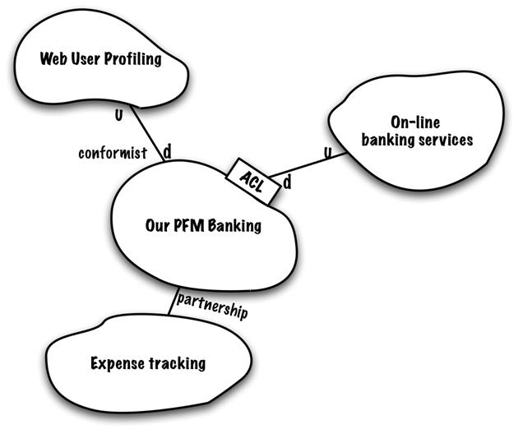
This is a Context Map

Slide 34
What is a Context Map?
A diagram of the solution space (Bounded Contexts) and the relationships that define the space
Includes the following:
Name of the Context
Upstream/Downstream relationship
Type of Relationship
The diagram is meant to be a living document that changes as systems change/get added

Slide 35
Types of Relationships - Partnership
Two contexts that will succeed or fail together
Teams working with contexts will coordinate releases to ensure success
Interdependent features should be included in the same release

Slide 36
Types of Relationships – Shared Kernel
Two contexts that have part of the model and code that have a very intimate dependency
This shared code should be kept very small
Changes to this model must be made with the knowledge of all working with the associated code
The model should align with the language within both contexts

Slide 37
Type of Relationships – Customer-Supplier
An upstream/downstream relationship where the downstream context is dependent on the upstream but not vice-versa
The upstream context, however, will listen to the downstream in a customer-supplier model
Typically downstream priorities should make it into upstream planning

Slide 38
Types of Relationships - Conformist
Upstream/downstream relationship where the downstream relationship is utterly dependent on the upstream
The upstream context will mostly have no knowledge of the downstream or will not care
The downstream context must adhere to any change made by the upstream context
Typically seen with 3rd party apis and integrations

Slide 39
Types of Relationships - Separate Ways
When two separate contexts truly have no relationship then they can decide to go there separate ways
Usually due to a overly expensive integration combined with low benefit

Slide 40
Types of Relationships – Anticorruption Layer
A downstream context is dependent on the upstream certain measures must be taken to ensure model purity
To achieve this a specialized layer is added to model and translate the upstream context into the language that the upstream context utilizes
This begins by modeling the upstream context into the specialized layer then adapting the upstream model into something that adheres to the downstream language
This maintains domain model purity

Slide 41
Types of Relationships – Open Host Service
A protocol that gives access to the context through a set of services (see APIs)
Enhance to meet future requirements
Use one off translators to handle special cases
Usually starts off as a customer-supplier as the supplier sometimes turning into the upstream end of the conformist

Slide 42
Types of Relationships – Published Language
Combined with an Open Host Service defining what the Open Host Service does
Well documented and shared, typically how a conformist defines to their implementers how to use their resources

Slide 43
Types of Relationships - Big Ball of Mud
A solution where the language boundaries are muddled and inconsistent
Draw a very large boundary and try not to spend too much time on modeling
Utilize an anticorruption layer to prevent dependencies leaking into a clean domain model

Slide 44
Again the Example Bounded Context

Slide 45
Notice
The U/D which indicates Upstream and Downstream relationship
The partnership has not upstream downstream as they are partners in development
Anticorruption layer, published language, and open host protocol are defined on the relationship line between contexts

Slide 46
Drawing a Bounded Context
Start by selecting a single context, preferably one being worked on now as a circle with the name in the middle
Figure out all solutions, including 3rd party, that interact with this single context and add them to the diagram
Add the relationship lines and figure out what kind of relationship each has with the system you are currently work on
When properly defined the Context Map is a key tool and defining how the team will interact with the outside contexts

Slide 47
Our Experiences in a Nutshell
After building our first context we started to think about everything in contexts: Payment Processing, PHI Logging, etc…
By moving to this model it makes the software we create more reusable by splitting the software concerns
We made a mistake early on by splitting what we thought were separate contexts into two different apps
Ended up merging the code together as they were actually two different modules
Made the decision early on the implement a third party solution to handle Authorization and Identification

Slide 48
Conclusions?
We need to list the subdomains we have within our organization and figure out the next highest priority after Form Builder
The feature has to be big enough to warrant the effort of splitting it off into its own context making it the core domain at the time
If it is then we can start to approach the problem by building out the context map, putting the team together, developing the language, etc…
In the meantime we can continue to ensure the Form Builder Domain Model is relatively pure and the language flushed out
We will also go through the Subdomain and Context Map exercises to gain experience

